Slide 1
SMU BIA - Midterm Review
Team Housing Regression

Slide 2
Project Overview
Data Cleaning & EDA
Linear Regression
Brief experimentation with RF
AGENDA
FOR
TODAY

Slide 3

Summary
Project Objectives
Practically apply coding and data analytics skills in Python on a real-world data set/problem
Explore the use of various regression modelling techniques
Using a wide spread of variables, determine the final price of each home
We used various libraries in Python to help with our analysis
Pandas (Data Wrangling, Cleaning)
Sklearn (Processing of data / Modelling)
Seaborn / Matplotlib (Visualisations)
Where we are now
Cleaned Data → Linear Regression Model → Tree-Based Models → Neural Networks → Conveying the results with Tableau

Slide 4

1. Project Overview

Slide 5
Data Set
The data set is taken from an ongoing kaggle competition.
The structure of the data set has 1460 rows and 80 columns
There are 80 explanatory variables which describe almost every aspect of residential homes in Ames, lowa.
Problem Statement(s)/Key Question(s)
What are key factors influencing the sale price of houses in Boston?
Which regression modelling technique provides the most accurate prediction of housing prices in Boston?

Slide 6

2. Data Cleaning & EDA

Slide 7
Data Cleaning
Thought process behind data cleaning - some key steps and considerations
What are our reasons for removing certain columns or variables?
Removed Variables:
Not Enough Data (NA) Alley Fence MiscFeature PoolQC FireplaceQu LotFrontage | Covered by other variables GarageCars GarageFinish HalfBath BsmtFullBath YearBuilt
Does not make intuitive sense Functional GarageType GarageYrBlt BsmtHalfBath LotConfig LotShape (Shape of property) PavedDrive (Paved/ Partial Pavement/ Dirt Gravel) MoSold SaleCond YrSold Condition 1 and Condition 2 | Imbalanced Data (More than 90% of the data is the same) 3SsnPorch BsmtCond GarageQual GarageCond Heating LandContour LandSlope LowQualFinSF PoolArea RoofMatl Street Utilities

Slide 8
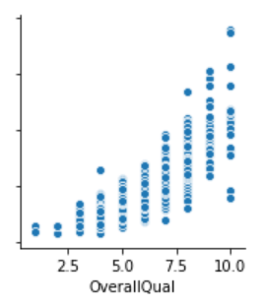
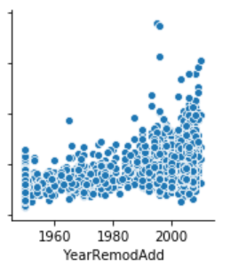
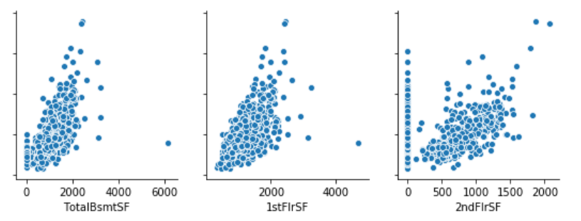
Exploratory Data Analysis
Scatterplots between certain variables
Correlation matrix / heatmap
Using seaborn, we plotted the sale price of the house against various variables and found a positive correlation.

Slide 9
3. Linear Regression

Slide 10
Linear Regression
We used sklearn to run a Linear Regression Model
The advantage of a stepwise regression model is that it provides an objective screening procedure for independent variables in developing a prediction model.

Slide 11
Lessons / Learning Points so far
Gain a better understanding of the role of regularisation
How sklearn can help deal with necessary data processing (standardisation / one-hot encoding)
Variable selection. Are there any other philosophies towards it we should consider?
How can we better deal with the missing data that we see

Slide 12
4. Next Steps

Slide 13
Timeline moving forward to complete project
Moving Forward
FEBRUARY 2020
EXPLORE MORE REGRESSION MODELS
Random Forests
Neural Networks
MARCH 2020
VISUALISATION
Explore more regression models
Pick up some Tableau for dashboarding or data visualisation
APRIL 2020
FINAL STRETCH
Consolidate models, codes and findings
Final presentation

Slide 14



Thank you!

